Slide 1
CAPSTONE PROJECT
PROJECT REPORT ON:
Plant Disease detection using image processing and machine learning
SUBMITTED BY:
SUBMITTED TO:
17BEI0077 - SHREY GUPTA
17BEE0288 – ISHAN GOEL
17BEE0358- RAHUL GUPTA
Dr. RAJINI GK
Associate Professor
School of Electrical Engineering

Slide 2
Previous Results:
We did 2 type of segmentation on our data and extracted 550 features out of it.
The 2 types of segmentation were
Masking Technique.
SLIC Technique.

Slide 3
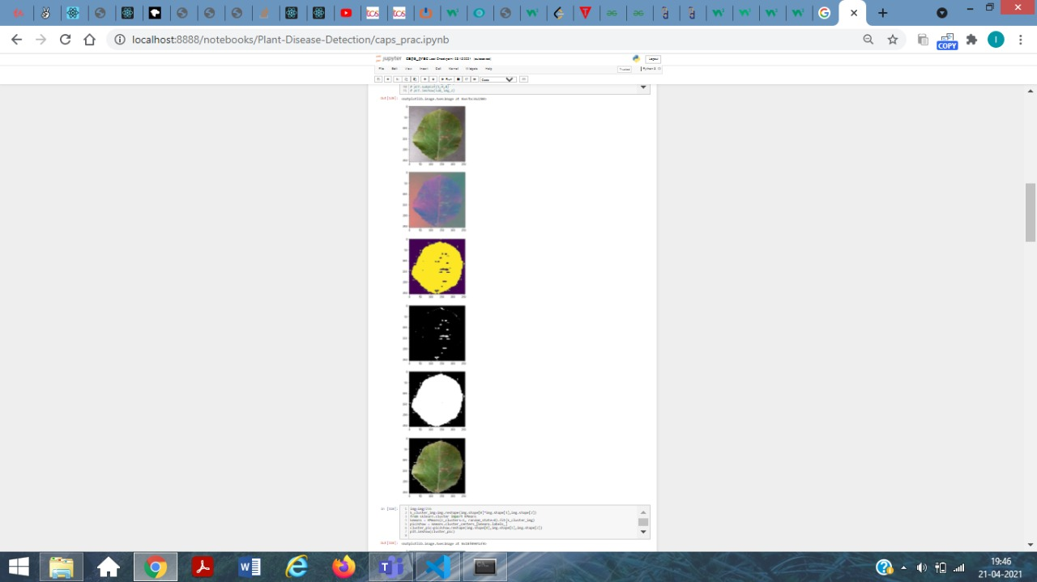
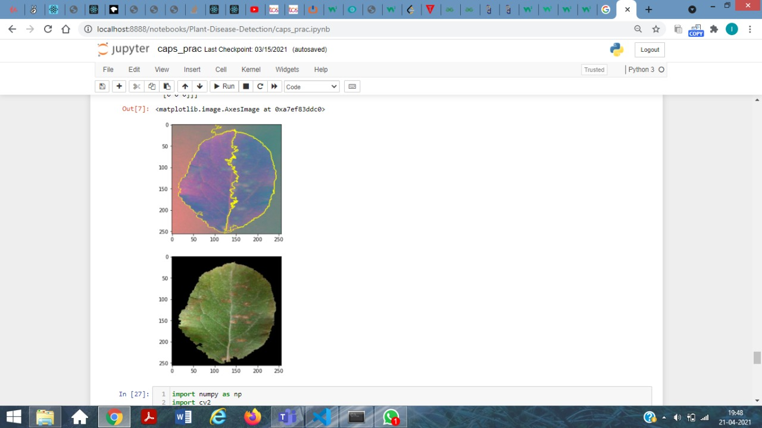
Segmentation Output:
Masking Technique
SLIC Technique

Slide 4
Introduction
In our project we have used and compared 2 different segmentation techniques and 3 different classifiers.
We have compared the result using 5 different factors:
Classifiers Used
Gaussian Naïve Bayes
Support Vector Machine
Random Forest
Segmentation Technique Used
Masking Technique
SLIC Technique
Comparison Factors
Accuracy
Precision
Sensitivity
Specificity
F1-score

Slide 5
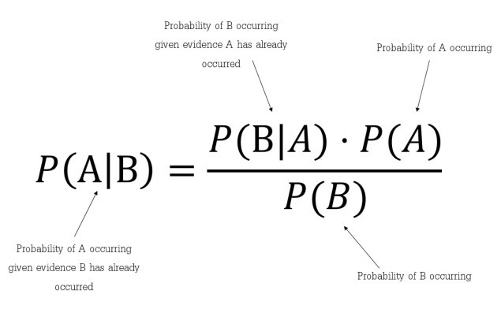
Classifier 1-Gaussian Naïve Bayes
Naïve Bayes is a probabilistic machine learning algorithm based on the Bayes Theorem, used in a wide variety of classification tasks.
Bayes’ Theorem is a simple mathematical formula used for calculating conditional probabilities.
Conditional probability is a measure of the probability of an event occurring given that another event has (by assumption, presumption, assertion, or evidence) occurred.
There is some assumptions made by this algorithm which impacts on the accuracy of this algorithm.
Assumptions: 1) It assumes all features are independent
2) It gives equal importance to all the features i.e. it assumes that all the features have equal weight in classification.

Slide 6
Algorithm
STEP 1: From Training set find the prior probability P(diseased)=(diseased)/(diseased + healthy) P (healthy)=(healthy)/(diseased + healthy).
STEP 2: Find the mean, variance for the all the 550 feature given the target is plant is healthy or diseased separately from the test data, i.e. if plant is healthy calculate the mean and variance of the given feature.
STEP 3: From the test data, for all the leaves we now predict whether that belongs to which class i.e healthy or diseased.

Slide 7

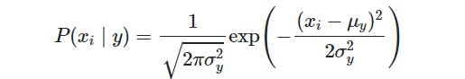

Using below mentioned formulas:
We can see that the denominator is constant for all thus we can create a proportionality:
We can calculate P(Xi/Y) as
Where:
P(y)=prior probability
μ$y$=mean of feature x given class Y or in this case diseased plant or healthy one (from training data)
X_{i=} i^{th} feature value for the test data
σ_{y}² =variance of feature x given class Y or in this case diseased plant or healthy one (from training data)

Slide 8
Classifiers Implementation And Results
Code:
import pandas as pd
import numpy
(trainDataGlobal, testDataGlobal, trainLabelsGlobal, testLabelsGlobal) = train_test_split(np.array(global_features),np.array(global_labels), test_size=test_size,random_state=seed)
clf_gauss=GaussianNB()
clf_gauss.fit(trainDataGlobal,trainLabelsGlobal)
NB_pr=clf_gauss.predict(testDataGlobal)
acc_NB = clf_gauss.score(testDataGlobal,testLabelsGlobal)
print('Accuracy',str(acc_NB*100)+"%")
cm=confusion_matrix(testLabelsGlobal,NB_pr)
print(cm)

Slide 9
Precision_NB=(cm[0][0])*100/(cm[0][0]+cm[1][0])
Sensitivity_NB=(cm[0][0])*100/(cm[0][0]+cm[0][1])
Specificity_NB=(cm[1][1])*100/(cm[1][1]+cm[1][0])
import seaborn as sm
sm.heatmap(cm,annot=True)
plt.xlabel('Predicted')
plt.ylabel('Actual')
print("[STATUS] splitted train and test data...")
print("Train data : {}".format(trainDataGlobal.shape))
print("Test data : {}".format(testDataGlobal.shape))
print("Precision=TP/TP+FP:",(cm[0][0])*100/(cm[0][0]+cm[1][0]),'%')
print("Sensitivity=TP/TP+FN:",(cm[0][0])*100/(cm[0][0]+cm[0][1]),'%')
print("Specificity=TN/TN+FP:",(cm[1][1])*100/(cm[1][1]+cm[1][0]),'%')
f_NB=2*(Precision_NB*Sensitivity_NB)/(Precision_NB+Sensitivity_NB)
print("F1-Score:",f_NB,'%')

Slide 10
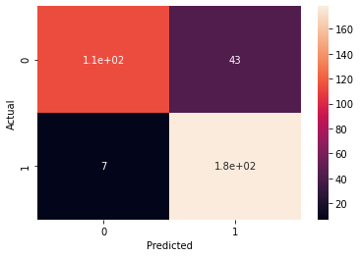
Output Using SLIC Segmentation Technique
Accuracy 85.38011695906432%
[[114 43] [ 7 178]]
[STATUS] splitted train and test data... Train data : (1367, 549) Test data : (342, 549)
Precision=TP/TP+FP: 94.21487603305785 %
Sensitivity=TP/TP+FN: 72.61146496815287 %
Specificity=TN/TN+FP: 96.21621621621621 %
F1-Score: 82.01438848920864 %

Slide 11
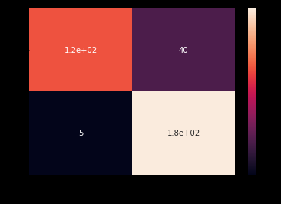
Output Using Masking Segmentation Technique
Accuracy 86.8421052631579%
[[117 40] [ 5 180]]
[STATUS] splited train and test data... Train data : (1367, 549) Test data : (342, 549)
Precision=TP/TP+FP: 95.90163934426229 %
Sensitivity=TP/TP+FN: 74.52229299363057 %
Specificity=TN/TN+FP: 97.29729729729729 %
F1-Score: 83.87096774193547 %

Slide 12
Inference
As stated earlier there are assumption used in this algorithm which is reflected in its accuracy.
Through confusion matrix we can see that out of 342 test data 45 we wrongly classified which is a lot.
We can also see that the accuracy using masking is higher than the SLIC technique.
We can also conclude that the performance of this algorithm is the worst when we compare it with random forest and SVM.

Slide 13
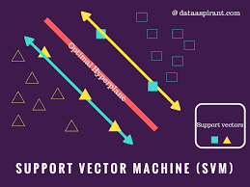
Classifier 2-Support vector Machine
This is a supervised machine learning algorithm which can be used for both classification and regression type of problems.
We are implementing this algorithm as two class classification algorithm but by applying some tweaks we can use it for multiclass classification.
It works well with larger amount of features and data as well.

Slide 14
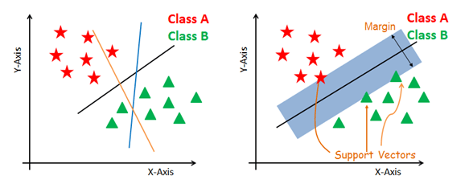
Suppose we have 2 features and want to classify in 2 broad categories shown in the figures.
The objective to SVM is to plot a hyperplane that divides the labelled data into 2 half's.
We also need to plot 2 planes parallel to hyperplane which passes through the nearest point to the hyperplane for both the categories. These points are called support vectors.
We can have multiple such hyperplanes but there is one more constraint i.e we need to maximize the margin distance.
Margin distance is calculated as distance between 2 margin lines.
Maths of SVM

Slide 15
Classifier implementation and Result
Code:
import pandas as pd
import numpy
from sklearn.svm import SVC
clf=SVC(random_state=9)
clf.fit(trainDataGlobal, trainLabelsGlobal)
pred=clf.predict(testDataGlobal)
from sklearn.metrics import accuracy_score,confusion_matrix
acc_svm = accuracy_score(pred, testLabelsGlobal)
print('Accuracy:',str(acc_svm*100)+"%")
cm=confusion_matrix(testLabelsGlobal,pred)

Slide 16
print(cm)
Precision_svm=(cm[0][0])*100/(cm[0][0]+cm[1][0])
Sensitivity_svm=(cm[0][0])*100/(cm[0][0]+cm[0][1])
Specificity_svm=(cm[1][1])*100/(cm[1][1]+cm[1][0])
import seaborn as sm
sm.heatmap(cm,annot=True)
plt.xlabel('Predicted')
plt.ylabel('Actual')
print("Precision=TP/TP+FP:",(cm[0][0])*100/(cm[0][0]+cm[1][0]),'%')
print("Sensitivity=TP/TP+FN:",(cm[0][0])*100/(cm[0][0]+cm[0][1]),'%')
print("Specificity=TN/TN+FP:",(cm[1][1])*100/(cm[1][1]+cm[1][0]),'%')
f_svm=2*(Precision_svm*Sensitivity_svm)/(Precision_svm+Sensitivity_svm)
print("F1-Score:",f_svm,'%')
plt.show()

Slide 17
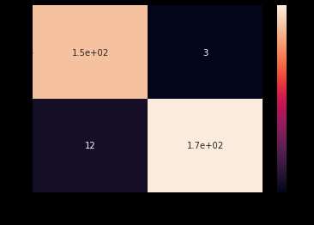
Output Using SLIC Segmentation Technique
Accuracy: 95.6140350877193%
[[154 3] [ 12 173]]
Precision=TP/TP+FP: 92.7710843373494 %
Sensitivity=TP/TP+FN: 98.08917197452229 %
Specificity=TN/TN+FP: 93.51351351351352 %
F1-Score: 95.35603715170278 %

Slide 18
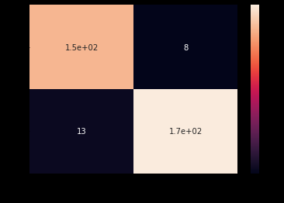
Output Using Masking Segmentation Technique
Accuracy: 93.85964912280701%
[[149 8] [ 13 172]]
Precision=TP/TP+FP: 91.9753086419753 %
Sensitivity=TP/TP+FN: 94.90445859872611 %
Specificity=TN/TN+FP: 92.97297297297297 %
F1-Score: 93.41692789968651 %

Slide 19
Inference
Accuracy of SVM and Random forest algorithm is comparable and very high this is because these algorithms don’t assume anything about features and weight of each features.
The accuracy using SLIC technique is higher than using masking technique.
Through confusion matrix we can see that out of 529 test data 21 we wrongly classified. This is less when we compare this to naïve bayes.

Slide 20
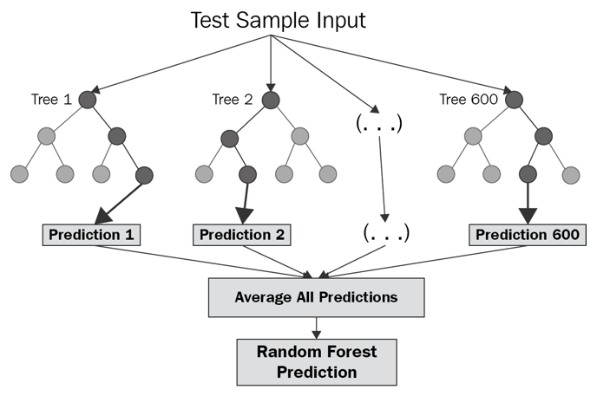
Classifier 3-Random Forest
This is a classification algorithm.
The subroutine of this algorithm is decision tree.
In this algorithm the split the data set and make different decision trees and then take an average and return the result.
Bagging method is used in Random Forest i.e. we fit multiple model in one algorithm.
While building subsets of data for trees, the word “random” comes into the picture. A subset of data is made by randomly selecting x number of features (columns) and y number of examples (rows) from the original dataset of n features and m examples.

Slide 21

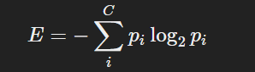
We split the data on the basis of:
Information Gain The information gain is the amount by which the Entropy of the system reduces due to the split that we have done. We have created the tree using observations. We split the with respect to feature X when Gain(S,A) is maximum among the remaining features.
Entropy is a measure of the randomness of a system. The entropy of sample space S is the expected number of bits needed to encode the class of a randomly drawn member of S. Lets suppose we have 14 rows in our data so 14 members.
The entropy of the system is calculated by the above formula where p(x) is the probability of getting class x from those 14 members(assuming). We have two classes here one is Yes and the Other is No in target column.
E(S)= -[p(Yes)*log(p(Yes))+ p(No)*log(p(No))];
Here yes means diseased otherwise healthy

Slide 22
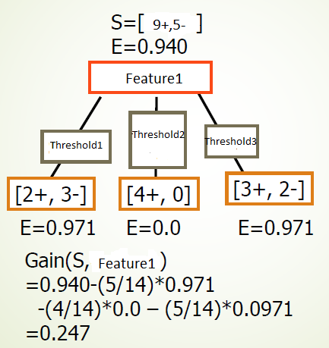

Slide 23

Conclusive Steps for Random Forest using previously mentioned formulas and concepts.

Slide 24
Classifier implementation and results
CODE:
from sklearn.ensemble import RandomForestClassifier
from sklearn.metrics import accuracy_score
import pandas as pd
import numpy
clf=RandomForestClassifier(n_estimators=1000,criterion='entropy',random_state=0)
clf.fit(trainDataGlobal,trainLabelsGlobal)
pred=clf.predict(testDataGlobal)
acc_rf=accuracy_score(pred,testLabelsGlobal)
print("Accuracy:",str(acc_rf*100)+"%");
cm=confusion_matrix(testLabelsGlobal,pred)
print(cm)
Precision_rf=(cm[0][0])*100/(cm[0][0]+cm[1][0])
Sensitivity_rf=(cm[0][0])*100/(cm[0][0]+cm[0][1])
Specificity_rf=(cm[1][1])*100/(cm[1][1]+cm[1][0])

Slide 25
import seaborn as sm
sm.heatmap(cm,annot=True)
plt.xlabel('Predicted')
plt.ylabel('Actual')
print("Precision=TP/TP+FP:",(cm[0][0])*100/(cm[0][0]+cm[1][0]),'%')
print("Sensitivity=TP/TP+FN:",(cm[0][0])*100/(cm[0][0]+cm[0][1]),'%)
print("Specificity=TN/TN+FP:",(cm[1][1])*100/(cm[1][1]+cm[1][0]),')
f_rf=2*(Precision_rf*Sensitivity_rf)/(Precision_rf+Sensitivity_rf)
print("F1-Score:",f_rf,'%')
importances=clf.feature_importances_
for x in range (0,len(importances)):
print("Feature {}:{}".format(x,importances[x]))
plt.subplots(figsize =(16,9))
plt.bar(np.arange(0,549),importances)
plt.show()

Slide 26
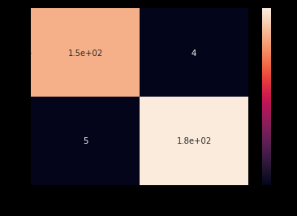
Output Using SLIC Segmentation Technique
Accuracy: 97.36842105263158%
[[153 4] [ 5 180]]
Precision=TP/TP+FP: 96.83544303797468 %
Sensitivity=TP/TP+FN: 97.45222929936305 %
Specificity=TN/TN+FP: 97.29729729729729 %
F1-Score: 97.14285714285715 %

Slide 27
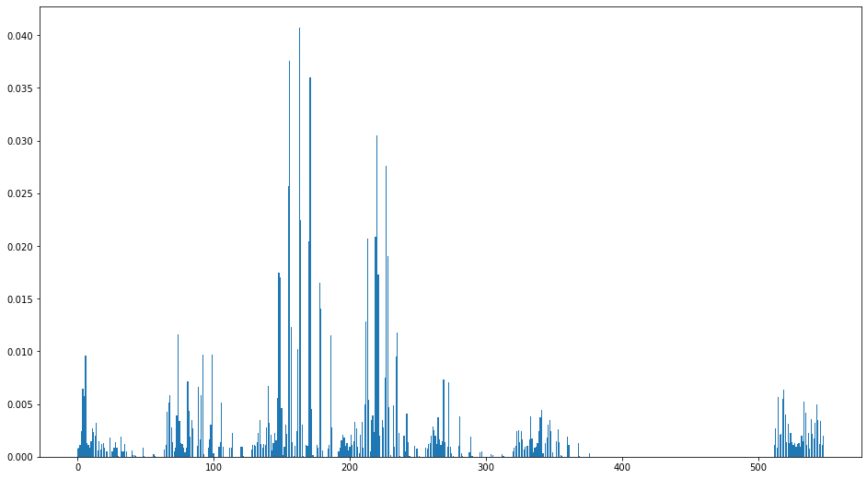
Contribution of Each feature in Classification

Slide 28
Output Using Masking Segmentation Technique
Accuracy: 97.36842105263158%
[[153 4] [ 5 180]]
Precision=TP/TP+FP: 96.83544303797468 %
Sensitivity=TP/TP+FN: 97.45222929936305%
Specificity=TN/TN+FP: 97.29729729729729 %
F1-Score: 97.14285714285715 %

Slide 29
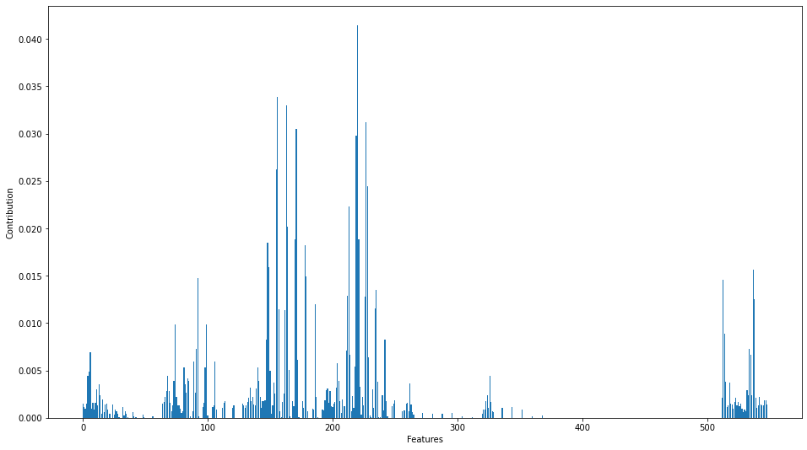
Contribution of Each feature in Classification

Slide 30
Inference
The training time of Random Forest was the highest as it checks for all possible splits at all the node.
Accuracy of Random Forest is around 98% using both the segmentation technique.
The confusion matrix suggest that 9 out of 529 test image were wrongly classified which is lowest compared to other two classifier.

Slide 31
Performance Analysis and Comparison of Algorithms.
Code:
import matplotlib.pyplot as plt
graph_data = [[acc_NB*100,acc_svm*100,acc_rf*100],
[Precision_NB,Precision_svm,Precision_rf],
[Sensitivity_NB,Sensitivity_svm,Sensitivity_rf],
[Specificity_NB,Specificity_svm,Specificity_rf],[f_NB,f_svm,f_rf]]
X = np.arange(3)
fig,ax = plt.subplots()
fig.set_figheight(10)
fig.set_figwidth(20)
rects1=ax.bar(X-0.250 , graph_data[0], color = 'b', width = 0.125,label='Accuracy')
rects2=ax.bar(X-.125, graph_data[1], color = 'g', width = 0.125,label='Precision')
rects3=ax.bar(X , graph_data[2], color = 'r', width = 0.125,label='Sensitivity')

Slide 32
rects4=ax.bar(X + 0.125, graph_data[3], color = 'y', width = 0.125,label='Specificity')
rects5=ax.bar(X + 0.250, graph_data[4], color = 'orange', width = 0.125,label='F1-score')
ax.set_xticks([0,1,2])
ax.set_xticklabels(["NB","SVM","RF"])
ax.legend()
def autolabel(rects):
for rect in rects:
height = rect.get_height()
ax.text(rect.get_x() + rect.get_width()/2., 1*height,
'%d' % int(height),
ha='center', va='bottom')
autolabel(rects1)
autolabel(rects2)
autolabel(rects3)
autolabel(rects4)
autolabel(rects5)
plt.show()
import pandas as pd
p_data = [["Gaussian Naive Bayes",acc_NB*100,Precision_NB,Sensitivity_NB,Specificity_NB,f_NB],
["Support Vector Machine",acc_svm*100,Precision_svm,Sensitivity_svm,Specificity_svm,f_svm],
["Random Forest",acc_rf*100,Precision_rf,Sensitivity_rf,Specificity_rf,f_rf]
]
perf_data=pd.DataFrame(p_data,columns=["Algo used","Accuracy(%)","Precision(%)","Sensitivity(%)","Specificity(%)","F1_score(%)"])
print(perf_data)

Slide 33
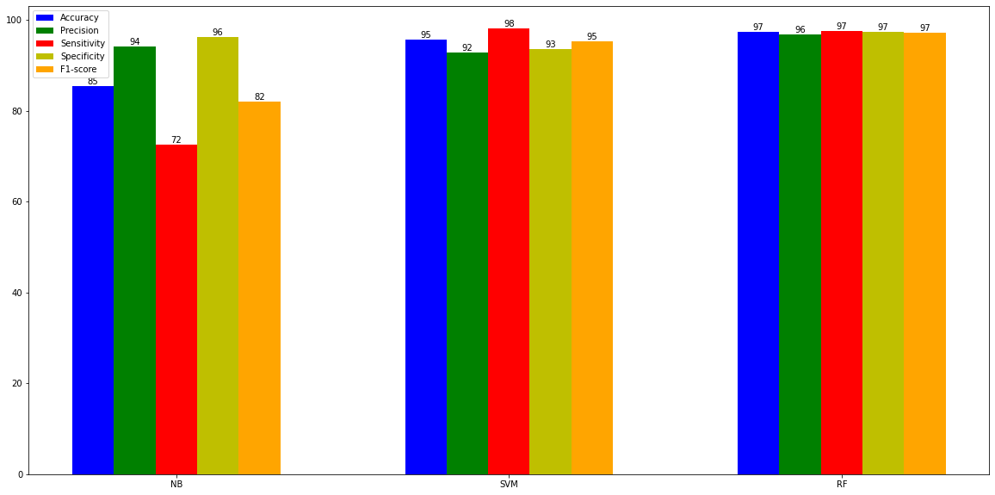
Bar Graph Comparison using SLIC segmentation

Slide 34
Comparison table
Algo used | Accuracy(%) | Precision(%) | Sensitivity(%) | Specificity(%) | F1_score(%)
Gaussian Naive Bayes | 85.380117 | 94.214876 | 72.611465 | 96.216216 | 82.014388
Support Vector Machine | 95.614035 | 92.771084 | 98.089172 | 93.513514 | 95.356037
Random Forest | 97.368421 | 96.835443 | 97.452229 | 97.297297 | 97.142857

Slide 35
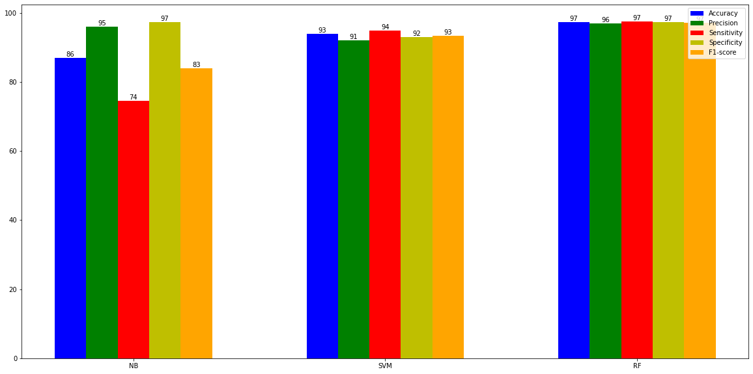
Bar Graph Comparison using Masking segmentation

Slide 36
Comparison table
Algo used | Accuracy(%) | Precision(%) | Sensitivity(%) | Specificity(%) | F1_score(%)
Gaussian Naive Bayes | 86.842105 | 95.901639 | 74.522293 | 97.297297 | 83.870968
Support Vector Machine | 93.859649 | 91.975309 | 94.904459 | 92.972973 | 93.416928
Random Forest | 97.368421 | 96.835443 | 97.452229 | 97.297297 | 97.142857

Slide 37
Basis of theoretical comparison:
The inherent method of approaching a problem is different in different kind of algorithms and this is exhibited through their characteristics. The characteristics of an algorithm can broadly be understood by focusing on key areas such as –
a) Accuracy: There is a general level of accuracy with sophisticated machine and deep learning algorithms generally having a high level of accuracy while on the other hand the traditional techniques do have a threshold and provide a descent accuracy and don’t out rightly fail which sometimes other algorithms do.
b) Interpretability: The question how we are being able to get the accuracy we are getting is sometimes important and this is where algorithms that provide high accuracy are so complex that their internal working is like a ‘black box’ and are less interpretable. It becomes difficult to understand what the model is doing as the calculations are so lengthy and complex and cannot be understood easily.
c) Type: Models can either be parametric or non-parametric. Parametric models are those where generally we have a mathematical equation involved which works under specific circumstances in order to function properly. In other words, there is set of strict assumptions that should be fulfilled which allow the algorithm that the data belongs to particular family of distributions and tries to create the line of best fit and make predictions. However, there are other models which can be categorized as non-parametric which have fewer requirements of assumptions to be fulfilled and create no mathematical equation in order to function. There algorithms can be rule based, distance based, probabilistic etc.
d) Data Size Handling Capabilities: Some algorithms can handle that which is in very high dimensions i.e. there are a large number of rows. Similarly, certain algorithm is best for dealing with big data.
e) Resistance to Multicollinearity: Some algorithms especially tree based algorithms are much more resistant to Multicollinearity than say traditional models.
f) Susceptibility to Outliers: Parametric algorithms are generally more vulnerable to outliers while others are not.
g) Assumptions: For some algorithm, there is a set of predetermined assumptions that should be satisfied in order for them to function properly while other, generally non-parametric algorithm have no or less rigid assumption requirements.
h) Training and Testing Phase: The time taken during the training and testing phase differs as certain algorithm that depend on a lot of small isolated calculation taking a lot of time during testing phase while algorithms where mathematical equations are involved take more time in training phase.

Slide 38
Algorithm | Type | Accuracy | Interpretability | Data Size Handling | Resistant to Multicollinearity | Susceptible To Outliers | Assumptions | Training Phase time | Test Phase Timings
Support vector Machine | Non Parametric | High | Medium | Large | No | Yes | Flexible | Medium | Low
Naïve Bayes | Probabilistic | Medium | Medium | Large | Yes | Yes | Flexible | Medium | Low
Random Forest | Rule Based | High | Low | Large | Yes | No | Flexible | High | Medium

Slide 39
Conclusions from comparison tables and graphs
1)Gaussian Naïve Bayes performs the worst among the three:
As It is a Parametric model ,where generally we have a mathematical equation involved which works under specific circumstances in order to function properly. In other words, there is set of strict assumptions that should be fulfilled which allow the algorithm that the data belongs to particular family of distributions.
Therefore its accuracy is less compared to others as its not flexible and assumes parameters are independent which might not be the case.
Another way to say this is that it usually isn’t the case that P(Z| X, Y) = P(Z|X) * P(Z|Y), which naive Bayes classification assumes.

Slide 40
2) SVM works better than Naïve Bayes
As it chooses the most optimal model of all the models its generate i.e. hyperplane with the maximum margin.
Kernel can be used to increase the dimensionality of the feature set, therefore making separation of data into classes easier than in the lower dimensionality.
But works less efficiently than random forest.
3)Random forest works best
as at each level of splitting the node it consider the best feature to separate into classes in the form of maximum information gain.
Since it’s a rule based algorithm ,so decision making is better than other algorithms.

Slide 41
SOURCE OF DATA SET:
https://github.com/spMohanty/PlantVillage-Dataset/tree/master/raw/color

Slide 42
Timeline:
Review 0: Submission of title
Review 1: Image processing on data set and extraction of features for ML Model
Review 2: Implementation of 3 ML Models and comparing the results.

Slide 43
References
https://towardsdatascience.com/
https://victorzhou.com/
https://haralick.org/journals/TexturalFeatures.pdf
https://en.wikipedia.org/wiki/Image_moment
Ko Ko Zaw, Zin Ma Ma Myo, and Wah Wah Hlaing. 2018. “Multiclass Support Vector Machine Based Detection and Classification of Leaf Diseases”, 11th National Conference on Science and Engineering, YTU, Yangon,
S. S. Panchal, R. Sonar. 2016. “Pomegranate Leaf Disease Detection Using Support Vector Machine,” International Journal of Engineering and Computer Science, vol. 5, no 6, pp. 16815-16818.
D. Gadkari. 2004. “Image Quality Analysis Using GLCM,” M.E. thesis, University of Central Florida, Orlando, Florida.
Cong, Jinyu & Wei, Benzheng & Yin, Yilong & Xi, Xiaoming & Zheng, Yuanjie. (2014). Performance evaluation of simple linear iterative clustering algorithm on medical image processing. Bio-medical materials and engineering. 24. 3231-8. 10.3233/BME-141145.

Slide 44
Prakash M. Mainkar, Shreekant Ghorpade and Mayur Adawadkar “Plant Leaf Disease Detection and Classification Using Image Processing Techniques” International Journal of Innovative and Emerging Research in Engineering Volume 2, Issue 4, 2015, e-ISSN: 2394 – 3343, p-ISSN: 2394 – 5494.
Sabah Bashir and Navdeep Sharma “Remote Area Plant Disease Detection Using Image Processing” IOSR Journal of Electronics and Communication Engineering (IOSRJECE) ISSN : 2278-2834 Volume 2, Issue 6 (Sep-Oct 2012), PP 31-34.
Dheeb Al Bashish, Malik Braik and Sulieman Bani-Ahmad “A Framework for Detection and Classification of Plant Leaf and Stem Diseases” 2010 IEEE International Conference on Signal and Image Processing, pp. 978-1-4244-8594-9/10.
Zulkifli Bin Husin, Abdul Hallis Bin Abdul Aziz, Ali Yeon Bin Md Shakaff and Rohani Binti S Mohamed Farook “Feasibility Study on Plant Chili Disease Detection Using Image Processing Techniques” 2012 IEEE Third International Conference on Intelligent Systems Modelling and Simulation, pp. 978-0-7695-4668-1/12.
Sachin D. Khirade, A. B. Patil, “Plant Disease Detection Using Image Processing” 2015 IEEE International Conference on Computing Communication Control and Automation, pp. 978-1-4799-6892-3/15.

Slide 45


